Slide 1
Hospital Management System
Are you Looking for about perfect System 🥸?
Here we Go..

Slide 2
Table of Contents
01
03
02
04
Introduction
System Architecture
The system aims to streamline and automate various processes within a hospital, including patient management, diagnosis recording, and administrative tasks.
The system is built using a multi-tier architecture
System Overview
User Roles and Permissions
The Hospital Management System provides a user-friendly interface for hospital staff to manage patient information, record diagnoses, update patient details.
The system defines main user role:
1-Administrator

Slide 3
Table of Contents
06
05
Functionalities
Database Structure
Login
Home Page
Add New Patient
Add Diagnosis
Update Patient Information

Slide 4
System Architecture
The system is built using a multi-tier architecture, comprising:
1-Presentation Layer: User interfaces such as login screens, home page, and forms.
2-Application Layer: Business logic and functionalities.
3-Data Access Layer: Interaction with the database.
User Roles and Permissions
The system defines two main user roles:
Administrator: Access to administrative functions such as managing users and system settings.
Medical Staff: Access to patient management, diagnosis recording, and updating patient information.

Slide 5
Database Structure
Admin Table
1-Stores information about the system administrator.
2-Fields: Admin_ID (Primary Key), Username, Password.
Patient Information Table
1-Stores details of patients.
2-Fields: P_ID (Primary Key), Name, Age, Gender, Contact Info, Address.
Diagnosis Table
1-Records diagnoses, medicines prescribed, and treatment details.
2-Fields: D_ID (Primary Key), P_ID (Foreign Key referencing Patient Information), Diagnosis, Medicine, Wrap, Type.

Slide 6
Functionalities:
Login
1-Allows users to authenticate into the system using their credentials.
2-Validates username and password against the Admin table.
Home Page
1-Displays essential options for users.
2-Buttons: Add New Patient, Add Diagnosis, Update Patient Information, Full History, Log Out.
Add New Patient
1-Enables medical staff to add a new patient to the system.
2-Collects patient details such as name, age, gender, contact info, and address.
Add Diagnosis
1-Allows medical staff to record diagnoses, prescribed medicines, wraps, and treatment type for patients.

Slide 7
Functionalities:
Update Patient Information
Allows medical staff to update patient details such as contact info and
address. Conclusion
The Hospital Management System streamlines hospital operations, ensuring
efficient patient management, accurate diagnosis recording, and improved
administrative tasks handling. With its user-friendly interface and robust
functionalities, the system contributes to enhanced healthcare services.

Slide 8
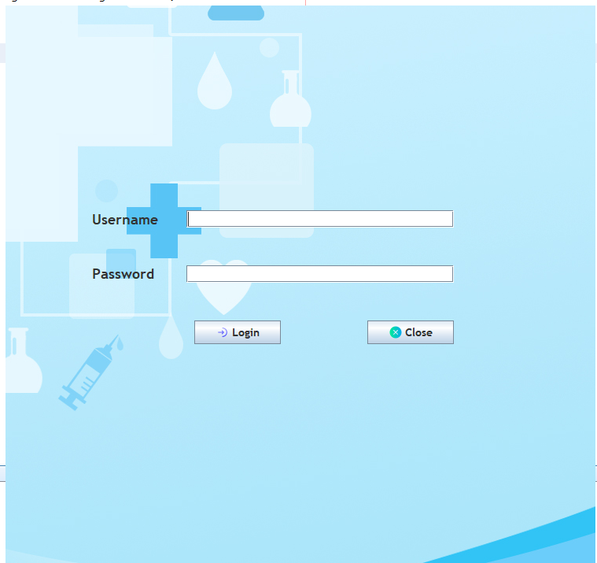
Some Photo From Our Project
Login

Slide 9

Some Photo From Our Project
Home

Slide 10
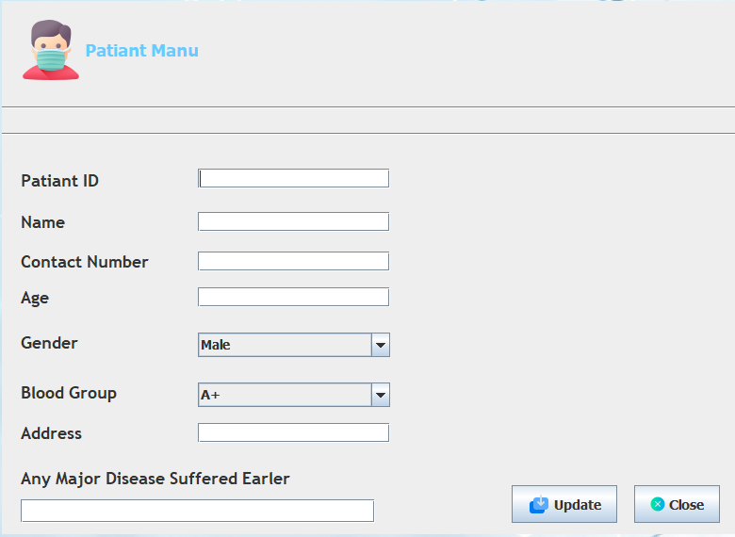
Some Photo From Our Project
Add Patient

Slide 11
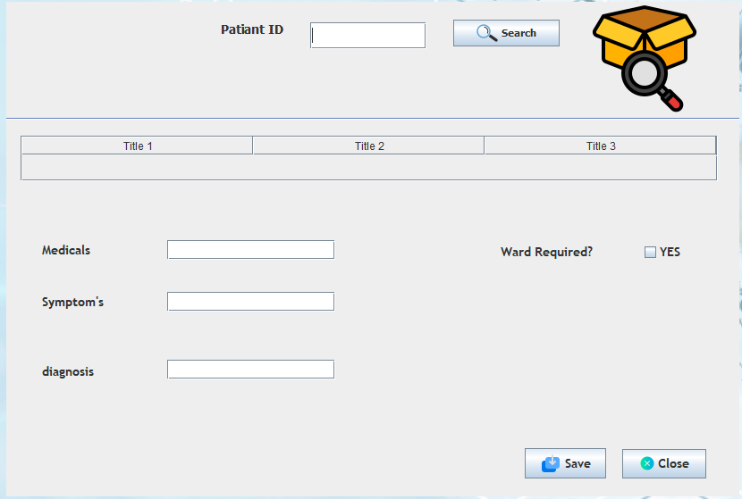
Some Photo From Our Project
Add Diagnosis

Slide 12
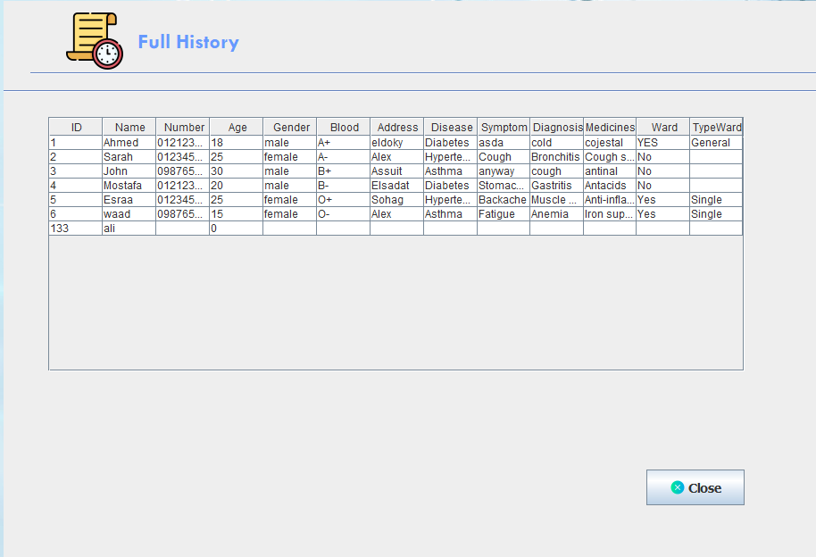
Some Photo From Our Project
History

Slide 13
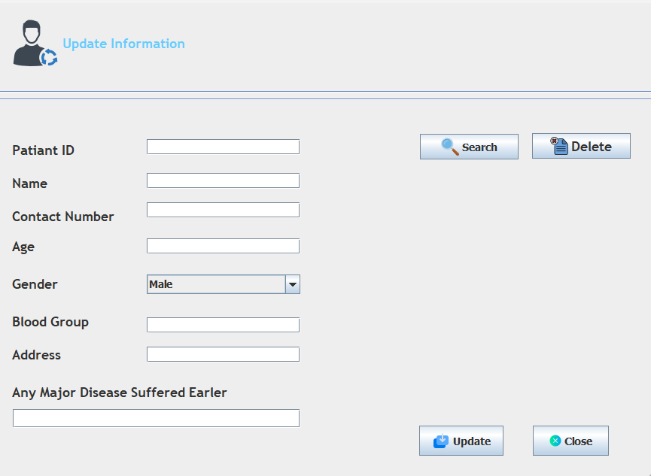
Some Photo From Our Project
Update Info

Slide 14
Thanks

